Slide 1
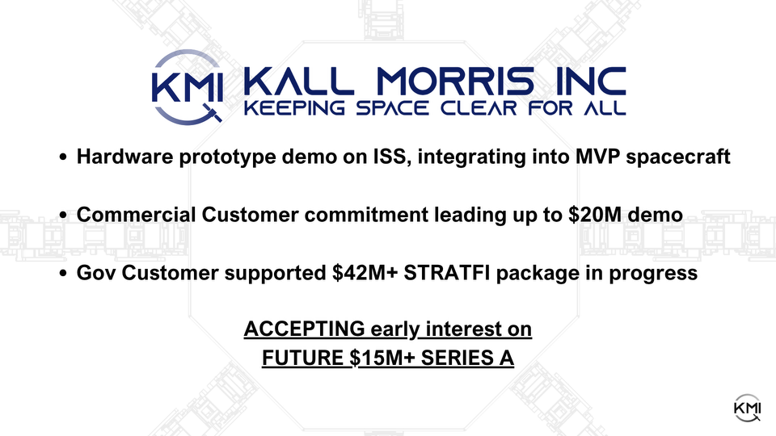
CLOSING $5M SEED
Contact: Troy M. Morris
Co-Founder & CEO
troy@kallmorris.com

Slide 2

Title
Relocation as a Service Spacecraft,
National Security Maneuvering
Contact: Troy M. Morris
Co-Founder & CEO
troy@kallmorris.com

Slide 3
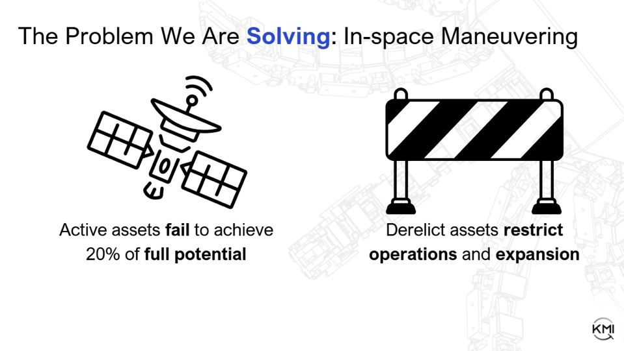
Problem
1

Slide 4
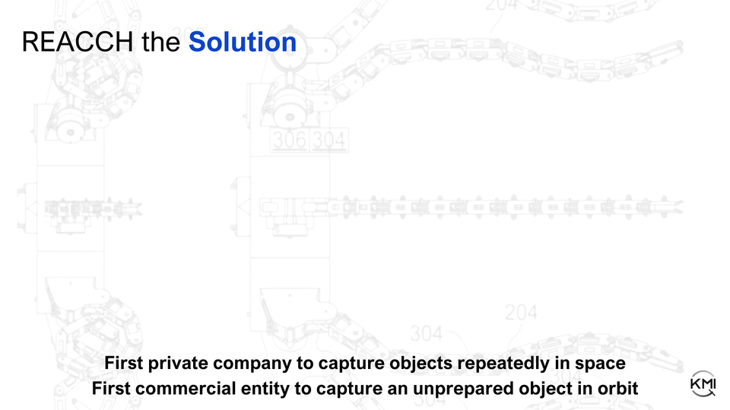
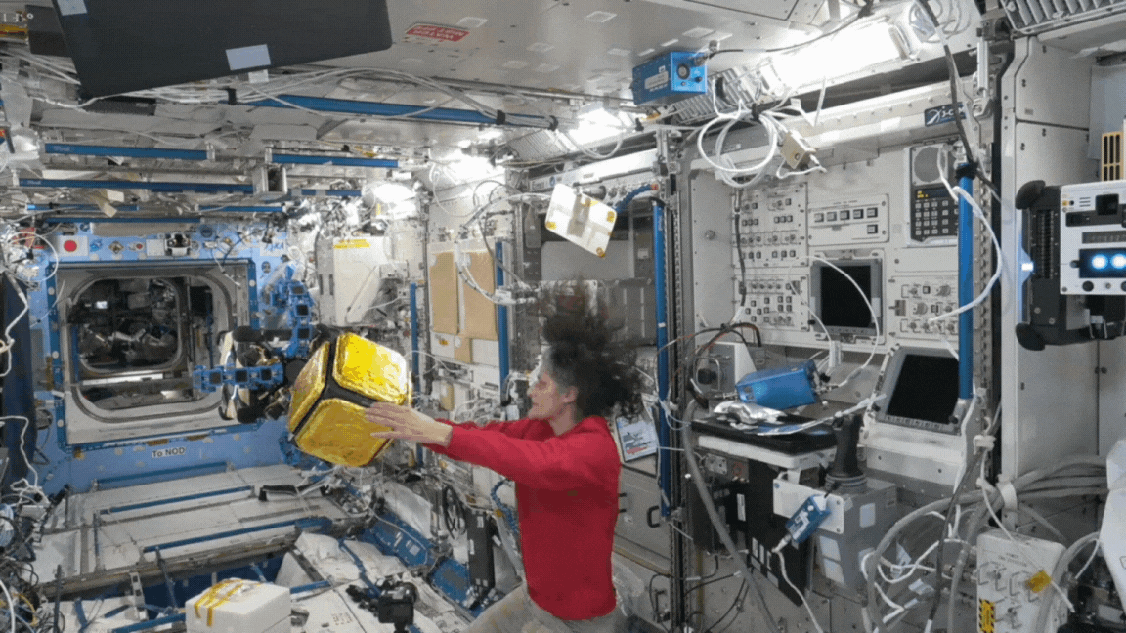

Solution
2

Slide 5
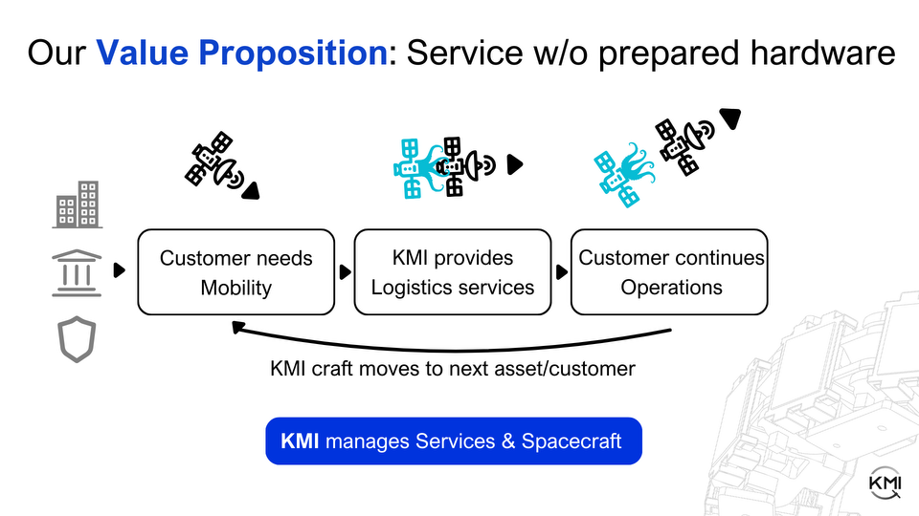
Value Prop
3

Slide 6
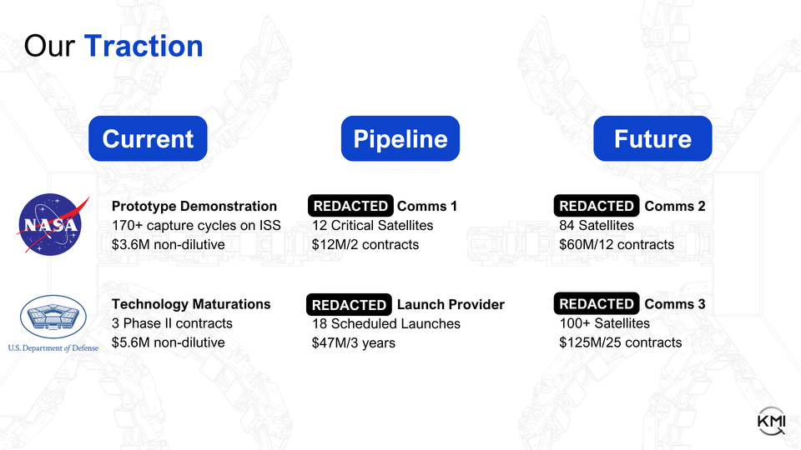
Customers
4

Slide 7
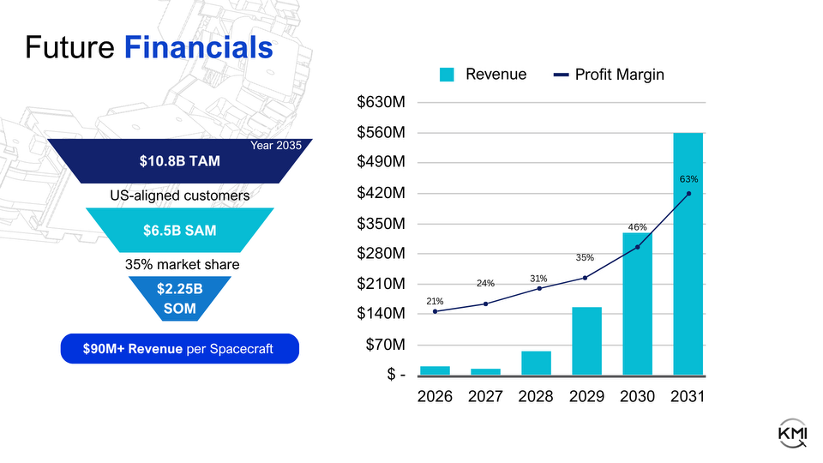
Financials
5

Slide 8
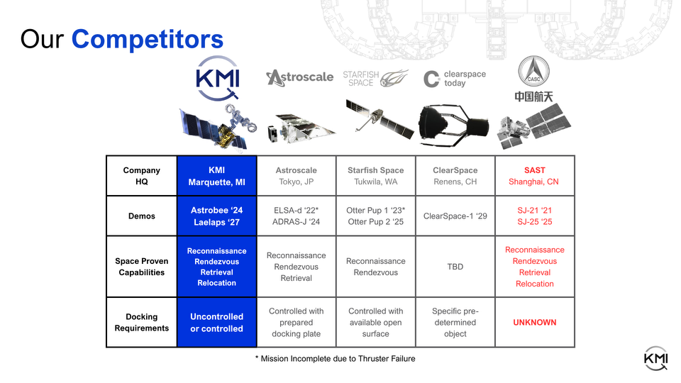
Competitors
6

Slide 9
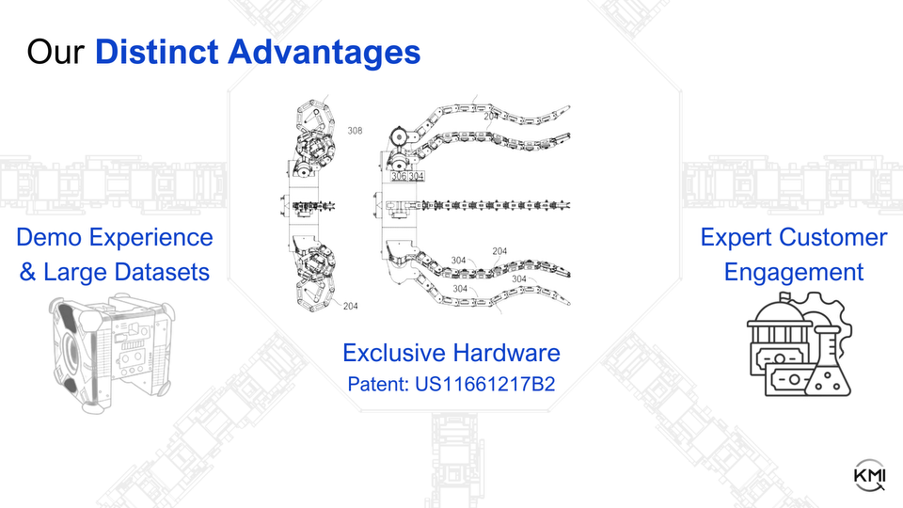
Advantages
7

Slide 10
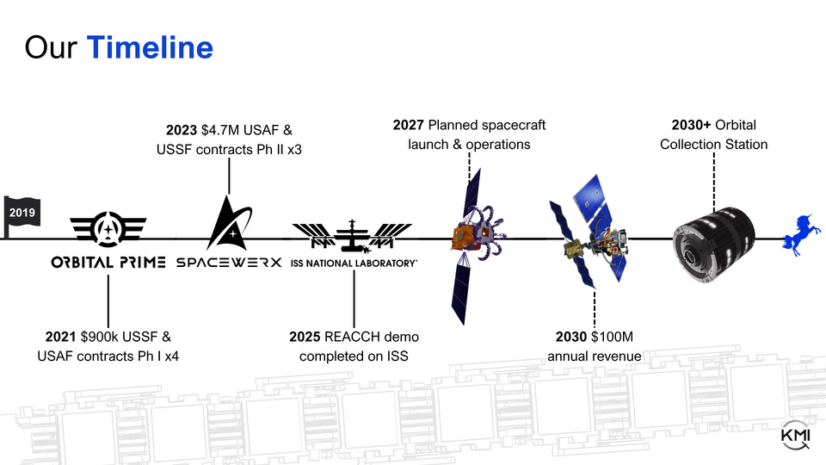
Timeline
Orbital Edge
2027 Planned spacecraft launch & operations
STRATFI
8

Slide 11
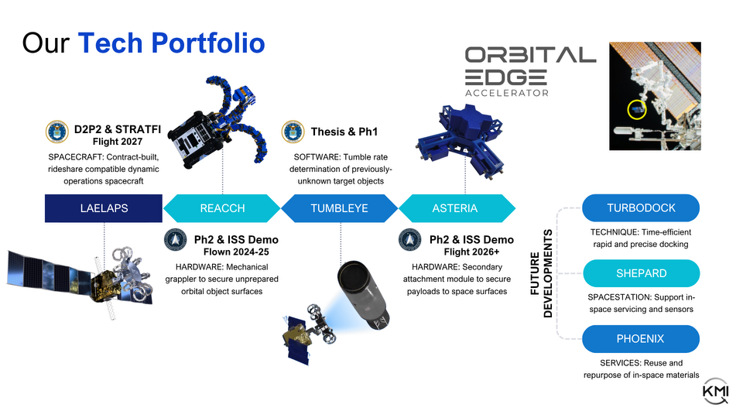

Tech Portfolio
9

Slide 12

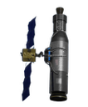
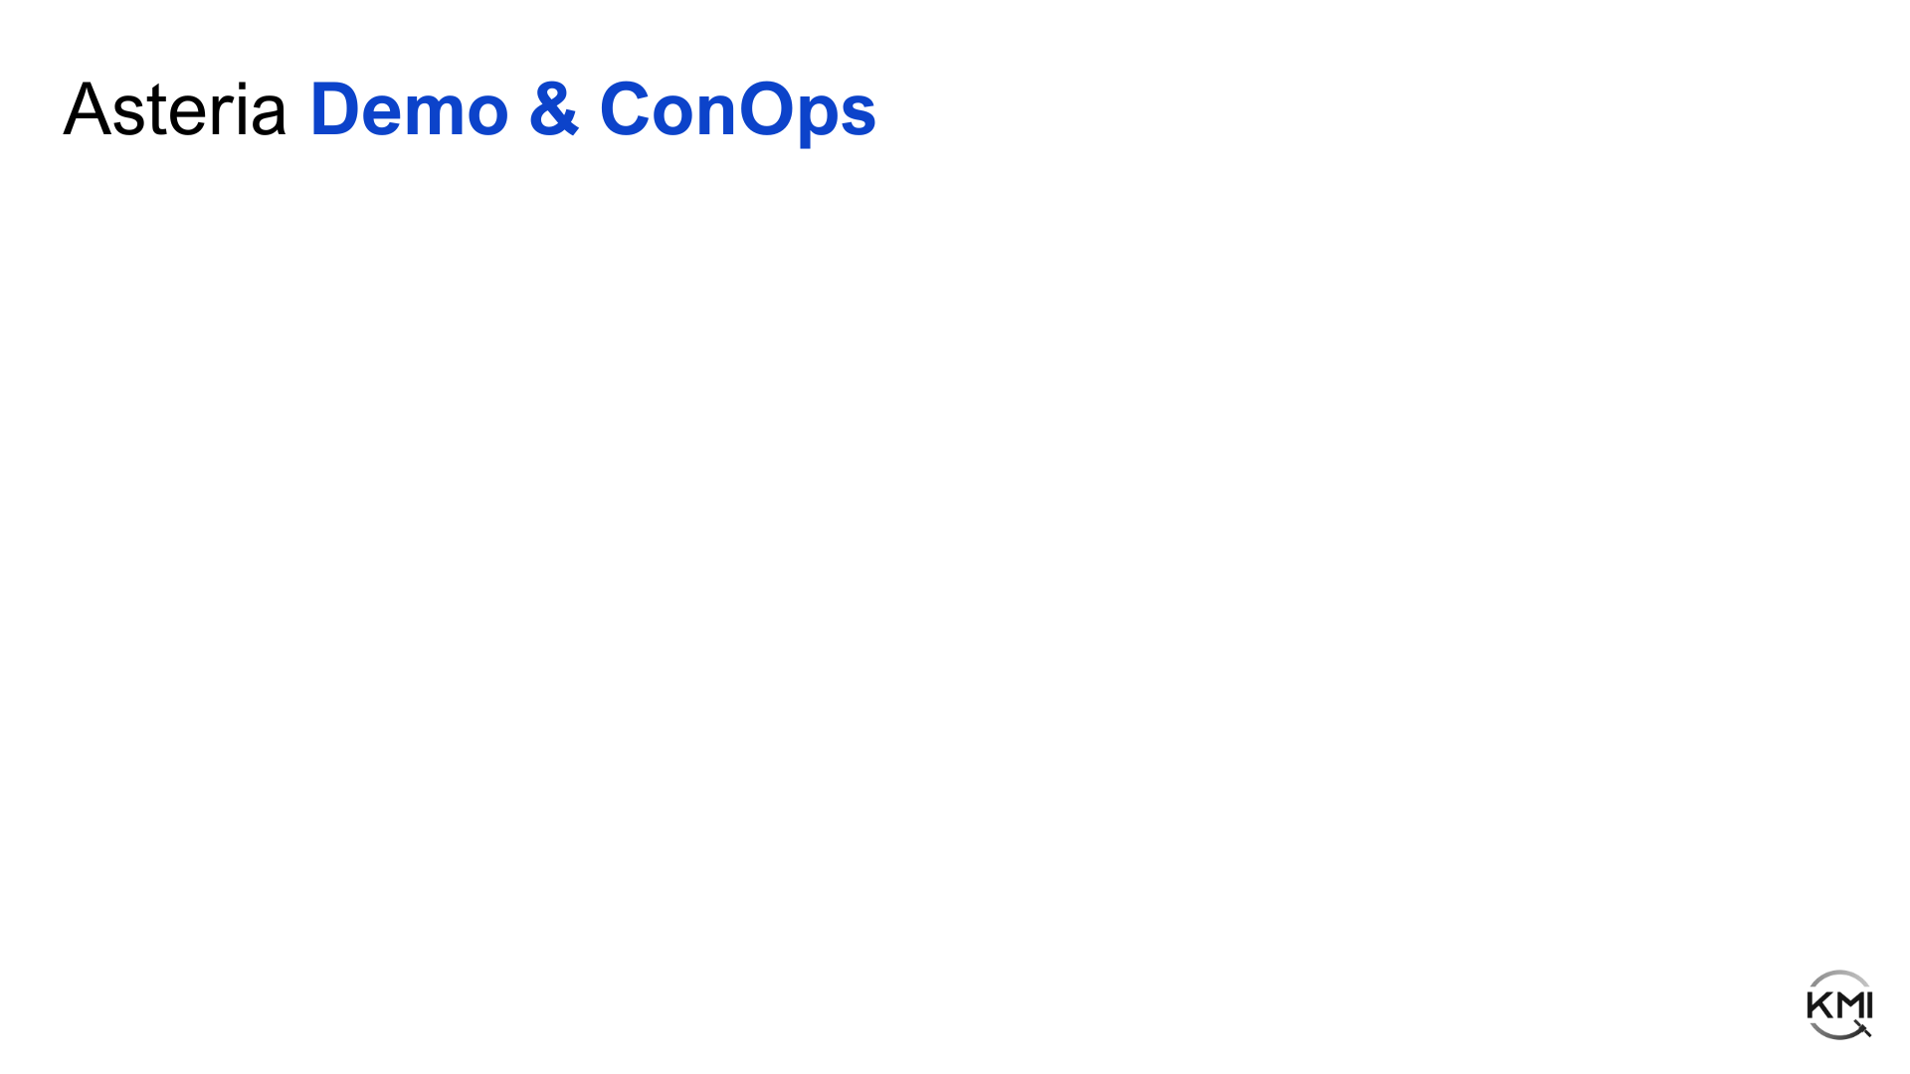
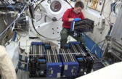

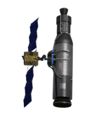
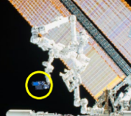



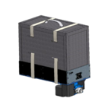
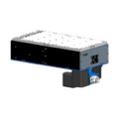
1
Approach client
Desired Payload
1
Unload and assemble Asteria
2
2
Install on MISSE Flight Facility (MFF)
Adhere Asteria hardware device
3
Monitor on MFF
4
3
Evaluate & return
Release & retreat to observe
4
Deploy Asteria payload for effect
10

Slide 13
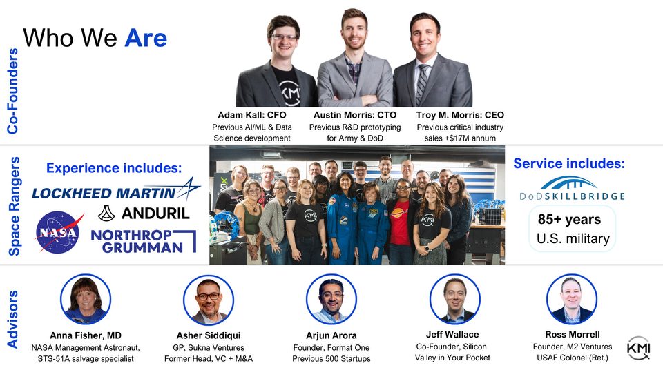

Team
11

Slide 14
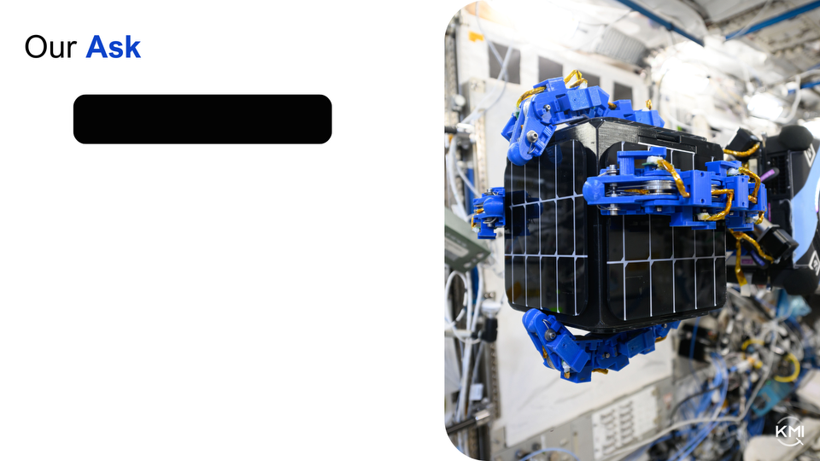
Current Ask
Closing Seed Round
Maintains Demo/Customer Timelines
Accelerates Tech & Business Dev
MILESTONES:
Contract STRATFI Award
Secure Commercial Contract
Ready Spacecraft for Final Integrations

