Slide 1


The Autonomy and
Precision Platform
Notes:
45 sec
Platforming mechanical and AI autonomy for precision movements
“Hi, I’m Alessandro Stabile, founder and CEO of Magma Space.”
“We’re building the next-generation satellite autonomy platform that combines AI autonomy and mechanical stability for high-performance operations.”

Slide 2
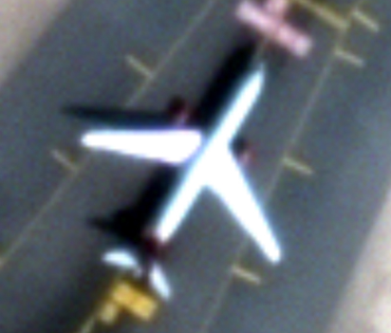
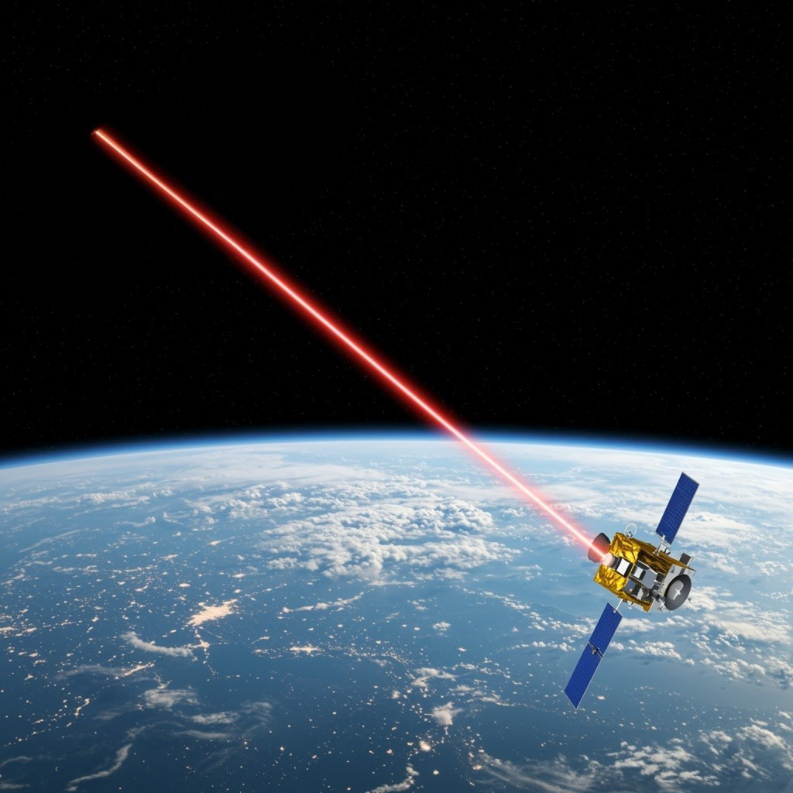
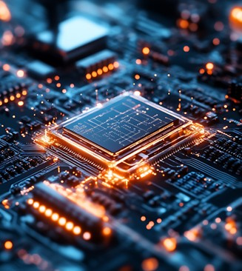
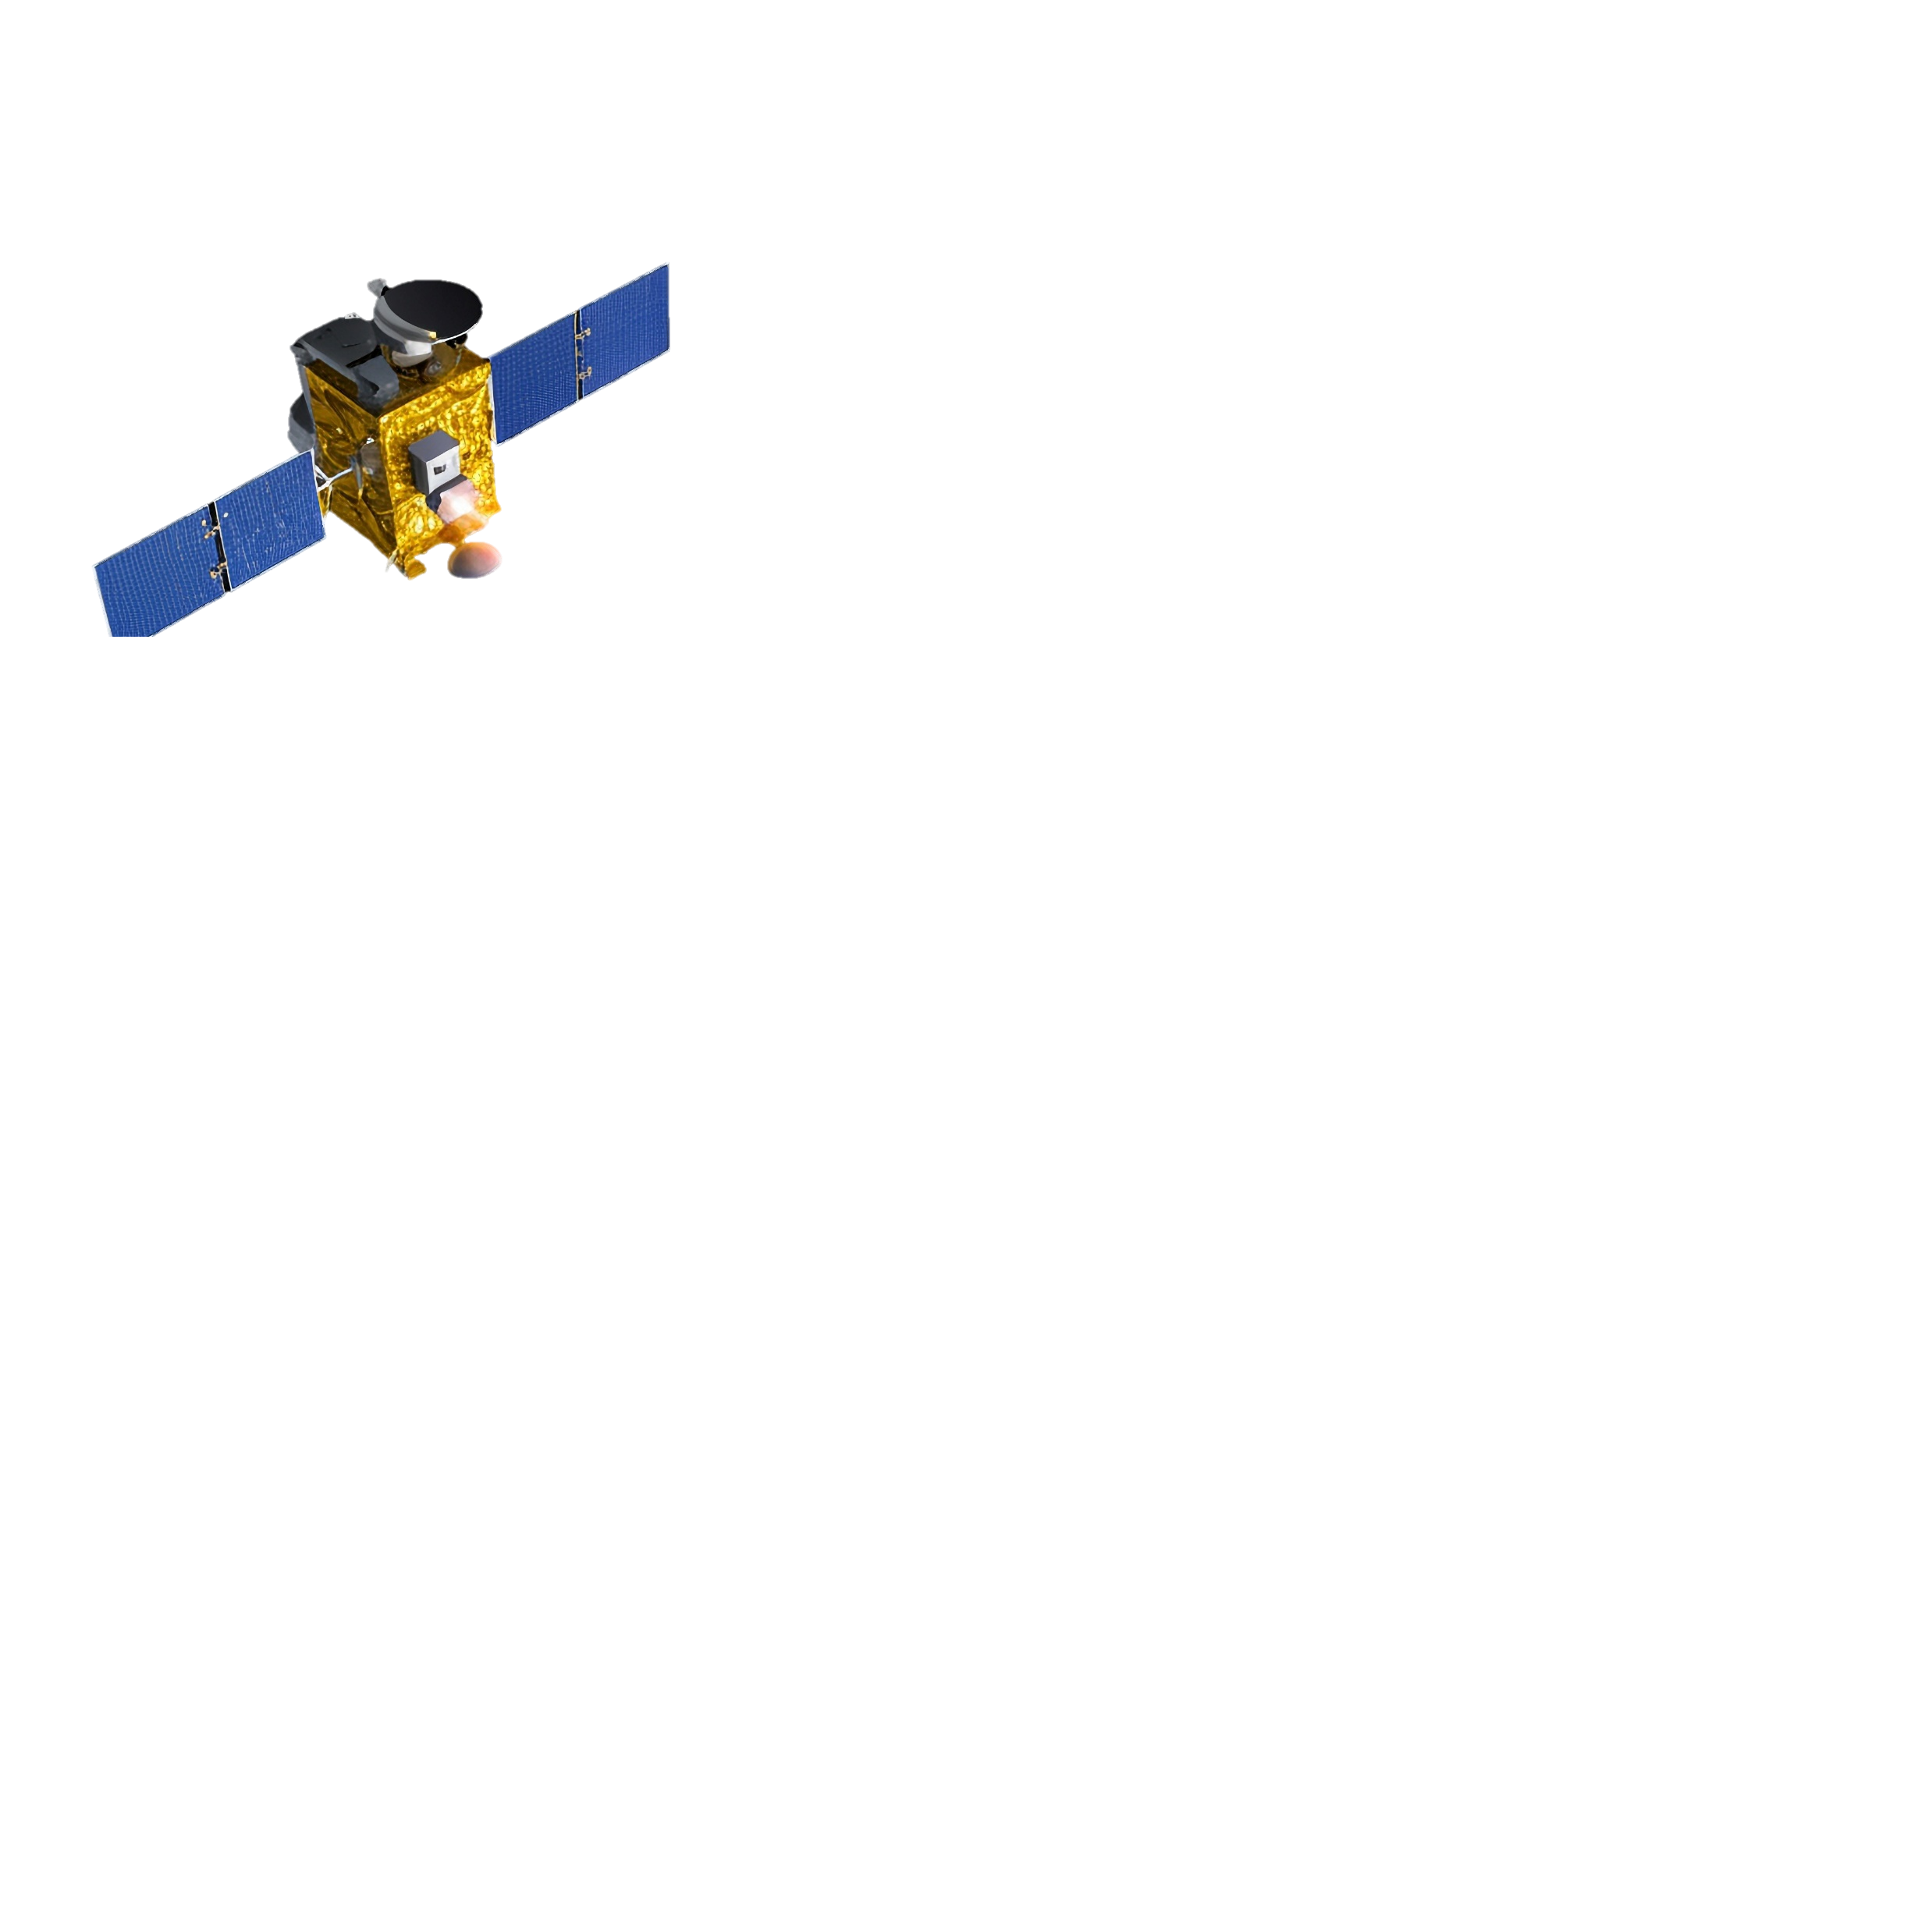
Ball Bearings Cause Jitter
in Every Satellite!
Conceals
detail
Reduces data rates
Prevents capabilities
$200B+
Untapped revenue due to instability

Slide 3
Jitter Pollutes Data and Breaks Trust
Sensing
Data
AI/ML
Algorithm
Control
Actuation
Noisy Data
Trained on
Flawed Data
Imprecise
Control
Noisy Data = Untrusted Autonomy
Notes:
Not just a mechanical issue but it affects also autonomy

Slide 4
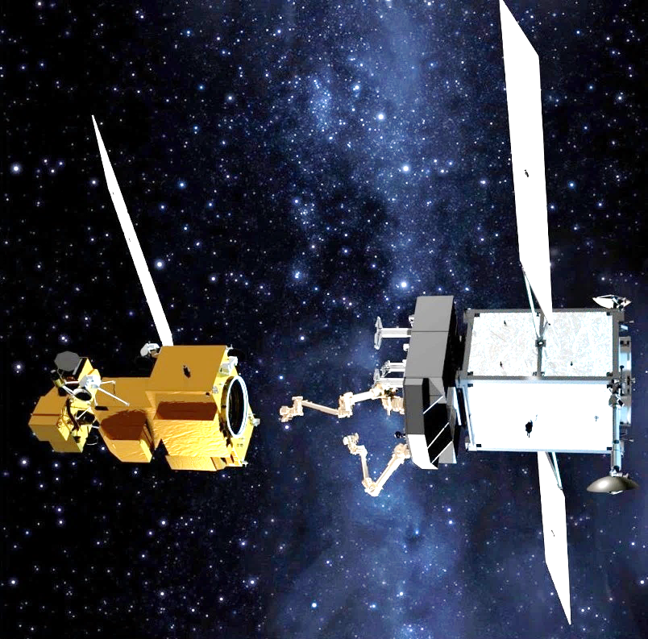
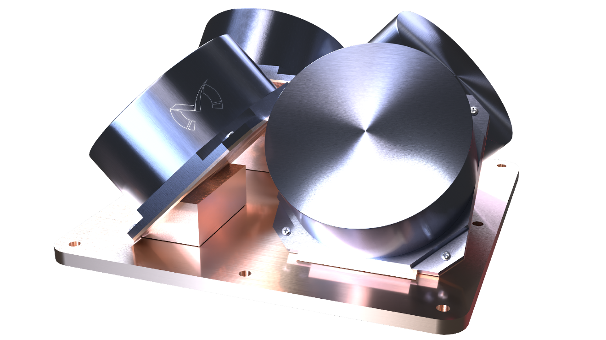
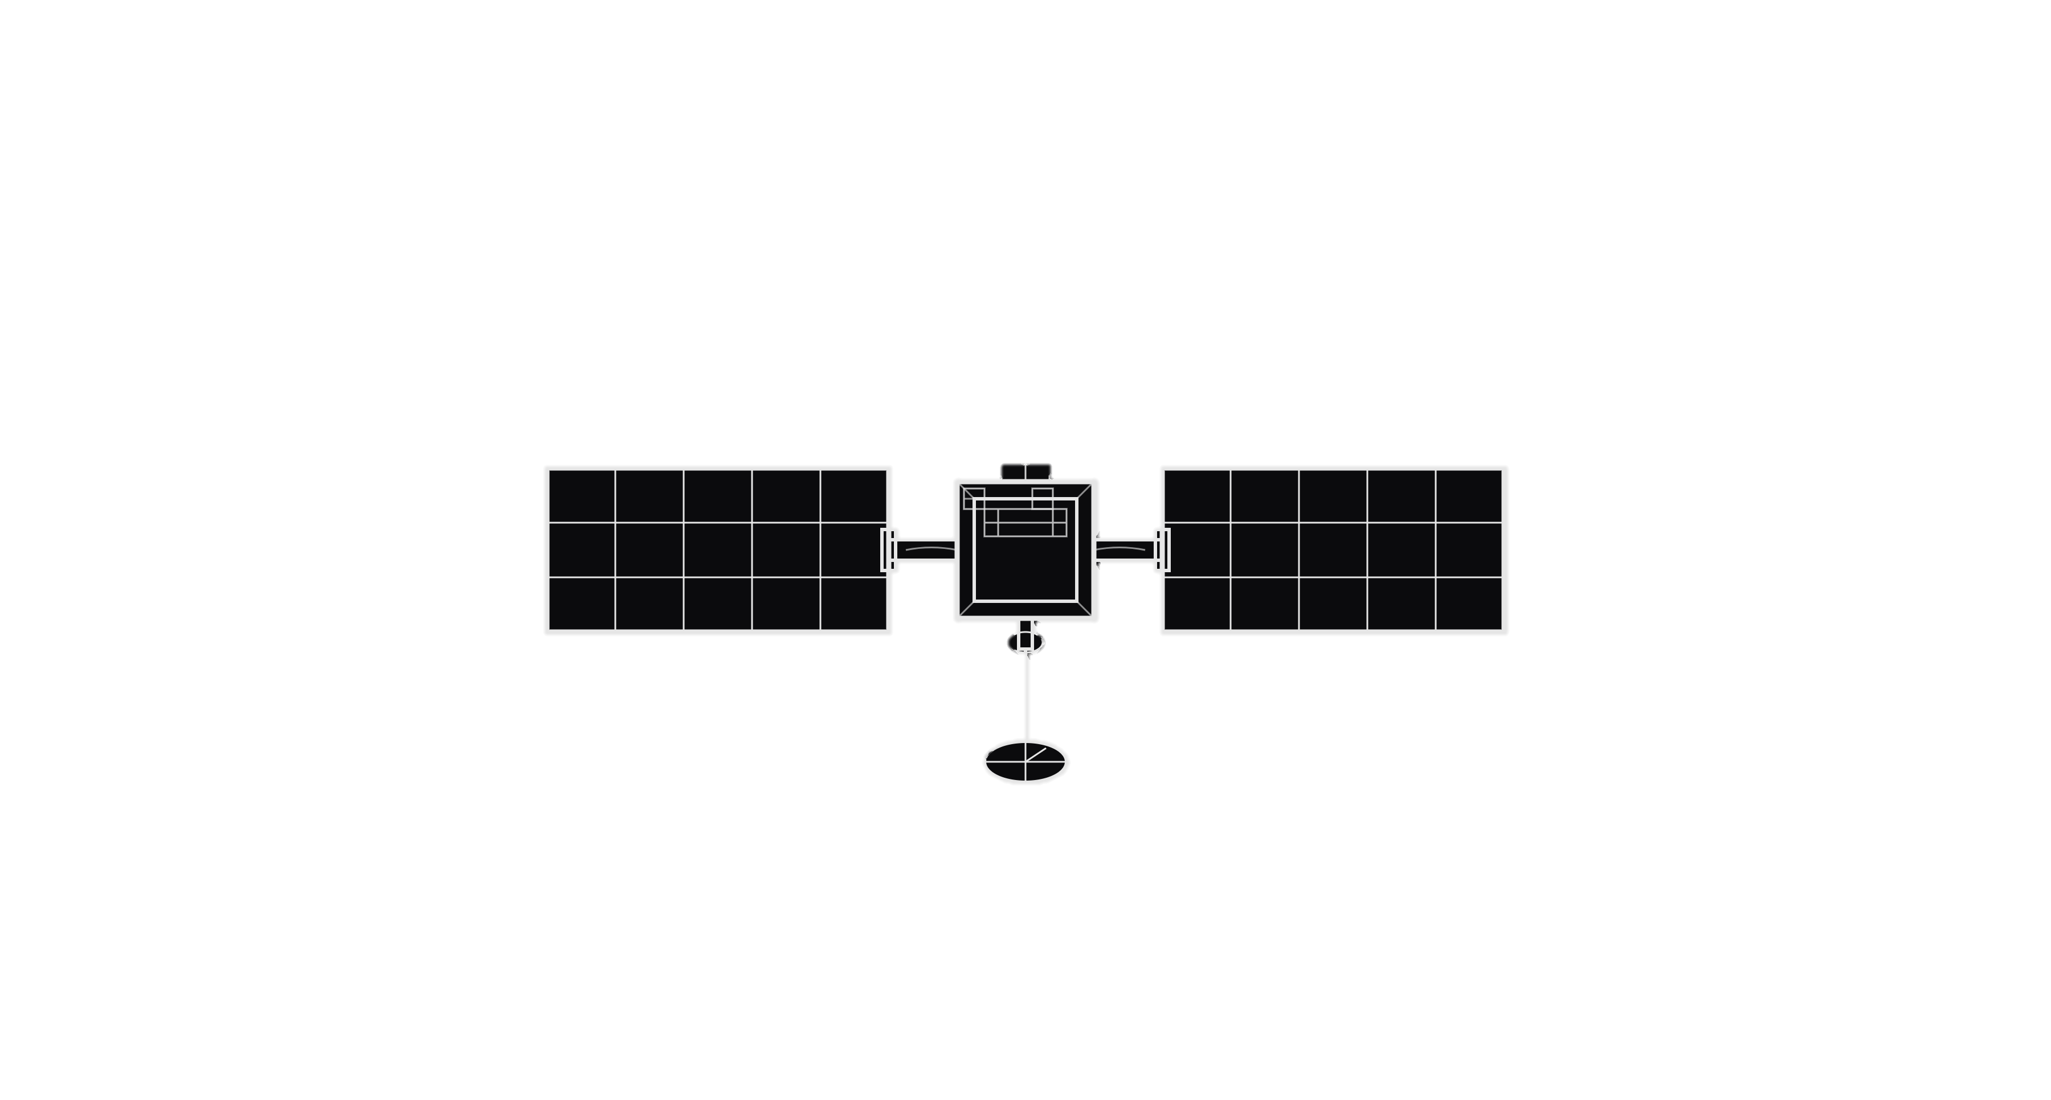
Magma Leverages Maglev for Trusted Autonomy
Mission Benefits
20X
Stability
40X
More Accuracy
10X
Better Agility
AI Stack
Hardware Foundation
Notes:
1’ 30s
AI enabling autonomous decision making as exemplified by our work on autonomous docking with the DOD
Auto-tasking
self-optimizing
It translates to unprecedented performance at the spacecraft level
Our AI autonomy stack uses machine learning for self-calibrating control, enabling satellites to perform complex maneuvers autonomously. It’s built on magnetically levitated reaction wheels that don’t just filter vibration, they eliminate jitter entirely because we removed the ball bearings We are unique on this and there nothing like it on the market.
Together, they form the Magma Platform — a generational leap in precision maneuvers. The hardware is the foundation of the AI, and no jitter means our autonomy can execute any precise operation instantly and reliably.
We can sell the hardware, the software, or the full integrated platform, but our focus is on the complete platform play — where the greatest impact and growth lie. In short, we don’t filter vibration — we eliminate it, unlocking true autonomy in orbit.

Slide 5








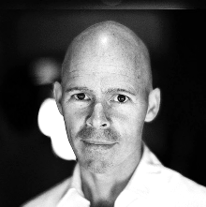
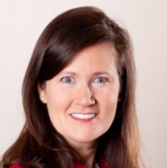

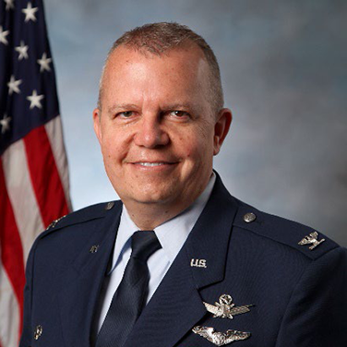
Industry-Leading Team and Advisors
Alessandro Stabile
Jordan Handler
Founder & CEO
Co-founder & COO
Advisory Board
Mike
Cassidy
Alexa
McCulloch
Doug
Sinclair
Col. Eric
Felt (Ret)

Slide 6









Strong Government and Commercial Support
$5M
$2M
$60M+
in non-dilutive R&D grants to date
Selected for
TACFI
in LOIs from companies like:

Slide 7
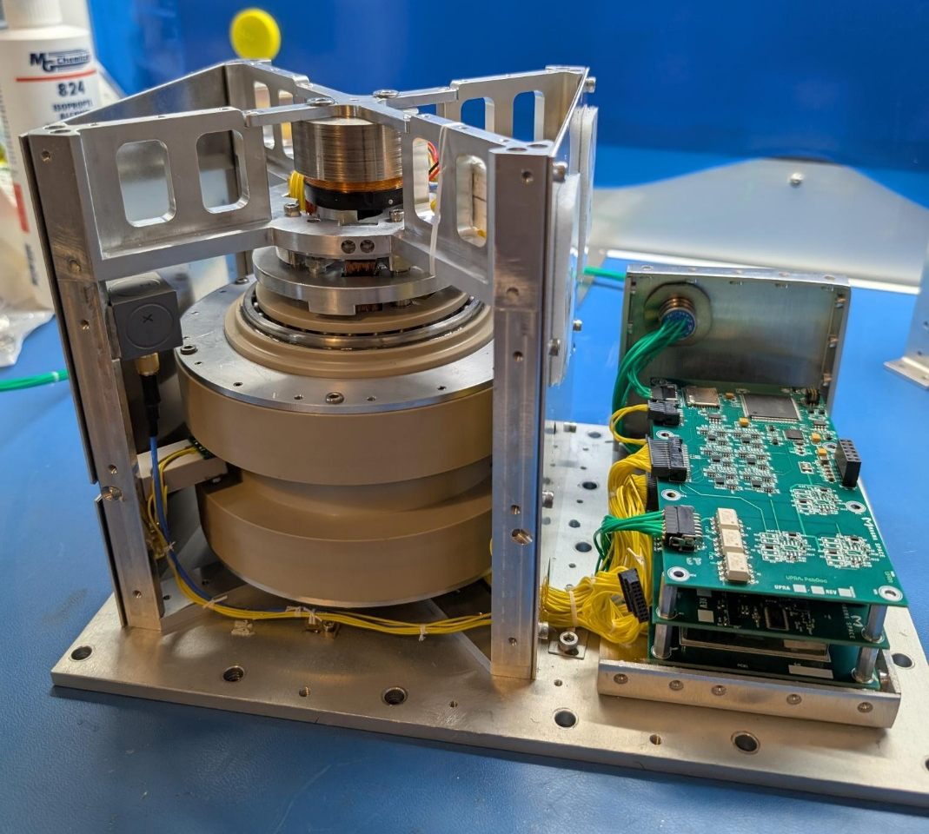
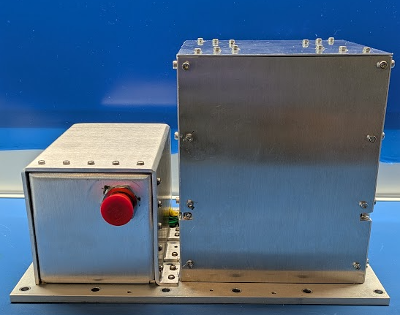
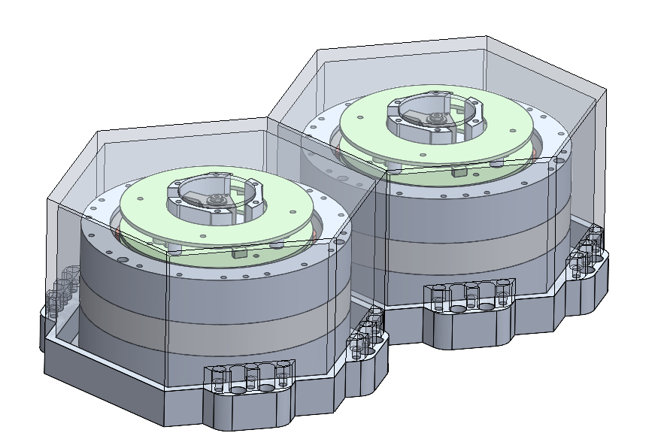
2 Tech Demos Funded by USG
K2 Space
ISS
Feb 2026
Q4 2026-Q1 2027

Slide 8
Ultra-Stable Hardware, AI Stack and Full Platform
PHASE 1
Ultra-Stable
Maglev Tech
PHASE 2
AI Control
Stack
PHASE 3
Autonomous Precision
Spacecraft
SOM
$2B
SAM
$30B
TAM
$150B
PRODUCT
LAUNCH
Maglev
Tech
AI Control Algorithms
AI Precision
Platform
REVENUE
$0.5M
$4M
$15M
$45M
$110M
2026
2027
2028
2029
2030

Slide 9
Raising $1.5M Seed Round
Space Force TACFI will match it 1:1
GTM Milestones:
Reaction wheel orbit validation
Conversion to binding LOIs
Set up reaction wheel supply chain
TRL8/9
$10M Revenue
GTM Production
Alessandro Stabile, CEO a.stabile@magma-space.com 202-843-7850

