Slide 1

Olfactory drugs to cure brain diseases
Parnian Lak, Ph.D. CEO

Slide 2

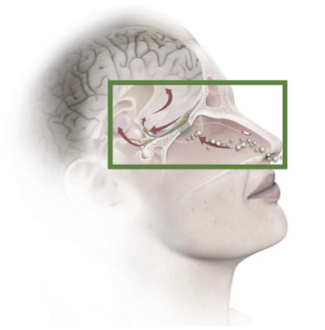
From hijacked pathway → healing pathway
The olfactory system
Unlock • Deliver • Regenerate

Slide 3



We develop olfactory drugs for efficient brain delivery and regeneration
For targeted delivery and regeneration
Human nose to brain cell culture model
Olfactory drugs
OChip
Unlock • Deliver • Regenerate

Slide 4

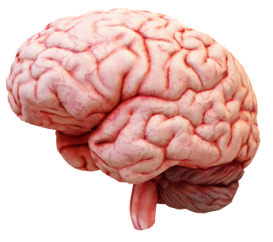
Why now
Growing aging population → rising Parkinson’s, Alzheimer’s
>90% brain drug discovery efforts fail
  Human-irrelevant models + slow diseases
  Blood Brain Barrier blocks delivery
COVID exposed the olfactory gateway
Unlock • Deliver • Regenerate

Slide 5
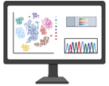

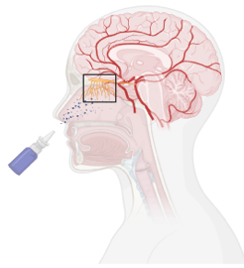
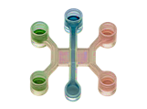



Design olfactory drugs
Synthesize olfactory drugs
Olfera platform
Test olfactory drugs,
high throughput
Unlock • Deliver • Regenerate

Slide 6
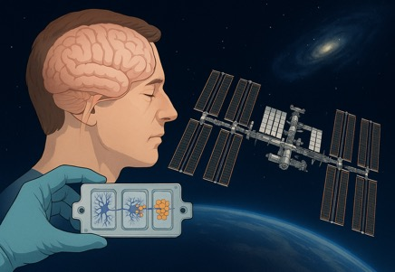
Human OChip at International Space Station for Parkinson’s drug discovery
Why space?
- Microgravity accelerates tissue aging
Translational data → Faster, cheaper go/no go → Success in clinical trials
Unlock • Deliver • Regenerate

Slide 7
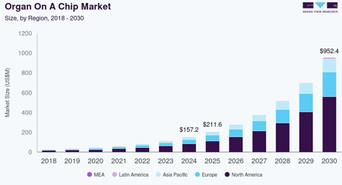
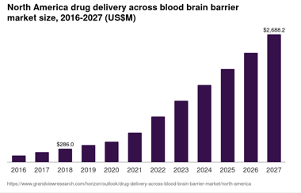
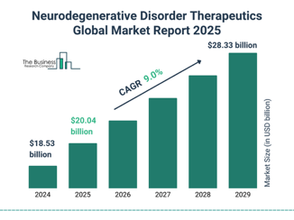
Opportunity
Unlock with OChip
Deliver with Olfactory drugs
Regenerate
$100B neurological drug market

Slide 8






Competition
Brain on Chips
Nasal brain drug delivery formulations
Parkinson’s therapeutics
The first primary human brain model + microgravity
Olfactory chemistry
Natural, regenerative pathway
Translational
Efficient, strong IP
First-in-class
Unlock • Deliver • Regenerate

Slide 9
Current programs
Indication | Modality | Development | Stage
Parkinson’s disease | Antisense oligonucleotide prodrugs | In-house | Animal studies
Alzheimer’s disease | Peptide olfactory prodrugs | In-house | Animal studies
Major Depressive Disorder | Small molecule olfactory drugs & prodrugs | In-house | Library synthesis
Neurological disease | Gene therapy olfactory prodrugs | With Pharma | Testing on OChip
Unlock • Deliver • Regenerate

Slide 10



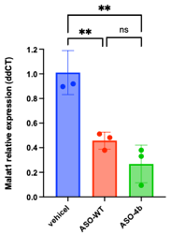
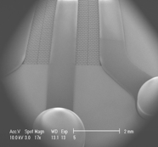
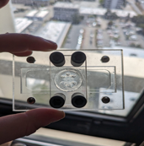
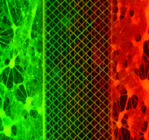
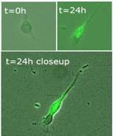

Traction
Raised $2 M
OChip is in a funded pilot collaboration with one of the top 5 global Pharma companies
Unlock • Deliver • Regenerate

Slide 11
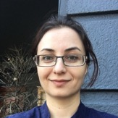
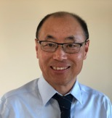
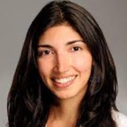
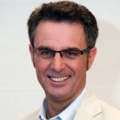




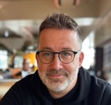


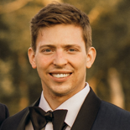




Team
Parnian Lak, PharmD, PhD
CEO (FT)
Jerry Yang, MD, MS
Neuropharmacologist (FT)
Zara Patel, MD
Chief Medical Advisor
Kelvin Cooper, PhD
Chief Medicinal Chemist
Lee Spraggon, PhD
Cell Biology Lead
Mike Prince
Advisor
Sandeepa Dey, PhD
Advisor
Brian Kopec, PhD
Advisor
Unlock • Deliver • Regenerate

Slide 12

Intellectual property: Patent portfolio
Device and Method of Use OChip
Composition of Matter Olfactory drugs
Unlock • Deliver • Regenerate

Slide 13








Roadmap
M&A
Demonstrate the power of the platform
Acquisition of assets and pipelines
2022
2026
2028
Commercialize the first-in-class olfactory drugs
Pharma partnership
Platform dev
Iterative drug testing
Clinical trials
$2M
$10M
$50M
Unlock • Deliver • Regenerate

Slide 14

Roadmap
Demonstrate the power of the platform
Acquisition of assets and pipelines
M&A
2022
2026
2028
Commercialize the first-in-class olfactory drugs
Pharma partnership
Platform dev
Iterative drug testing
Clinical trials
$2M
$10M
$50M
IND-enabling data
Unlock • Deliver • Regenerate

Slide 15







Platform with Assets
Key Activities Developing new drugs Developing OChip | Key Partners Pharma ISS | Value Propositions BBB bypass for drug delivery Predictive human model First-in-class drugs
Differentiators Niche space Unique platform with several therapeutic assets | Revenue Streams Paid pilots Out-licensing platform and assets Asset commercialization revenue | Use of Funds R&D, Lab ops CRO Space ops IP/regulatory
Exit: Acquisition of assets (OChip & data) and pipelines (Olfactory drugs)
Unlock • Deliver • Regenerate

Slide 16
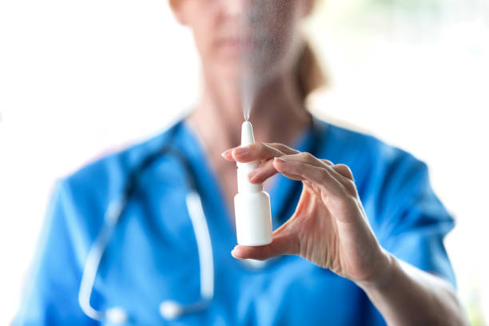
Building a better future
Unlock the potential of the olfactory pathway
Deliver what can’t cross the blood brain barrier
Regenerate brain circuits that can recover

