Slide 1
QOOLING ADVANCED ELECTRONICS FASTER
P I T C H
D E C K
W W W . Q U A N T U M Q O O L . C O M

Slide 2




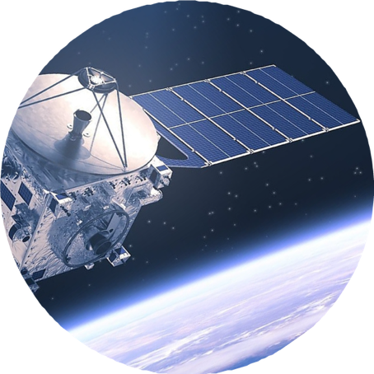
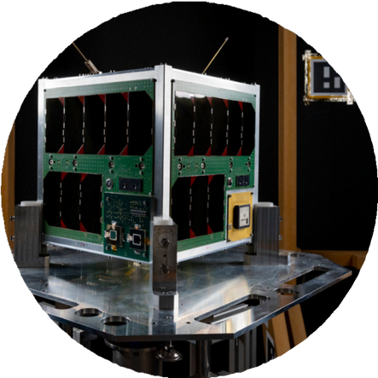




THE PROBLEM
GOOD
Spacecraft are becoming more cutting-edge, robust and powerful than ever
EVEN BETTER
They're handling more compute and payloads than ever in smaller form factors
MAJOR
PROBLEM
They're creating exponential amounts of heat
LARGE SATELLITES | CUBESATS
| ROVERS | LANDERS

Slide 3


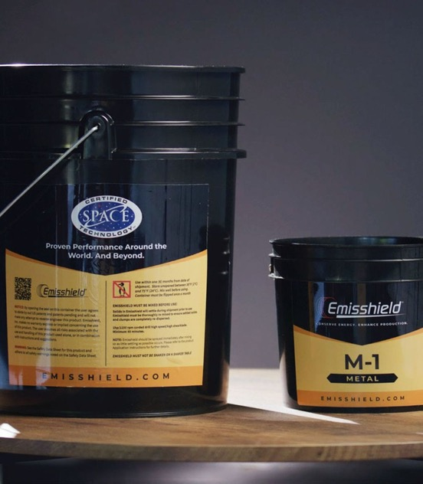
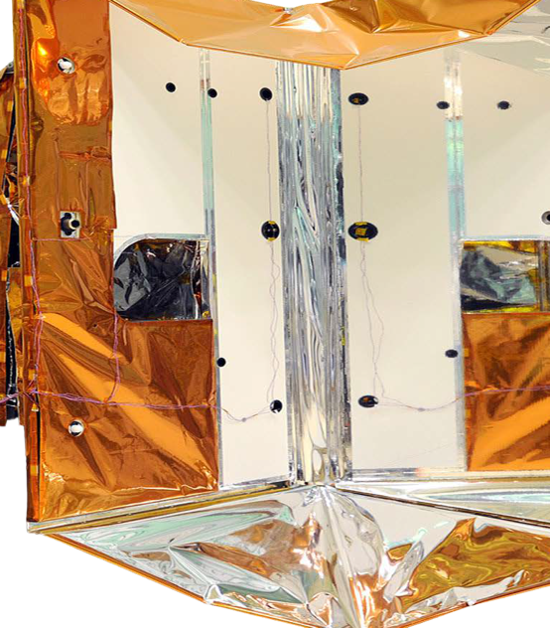
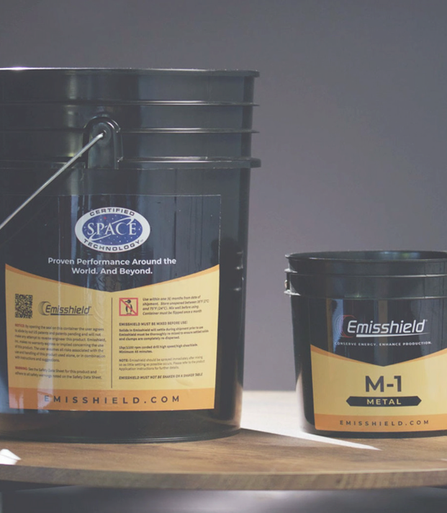

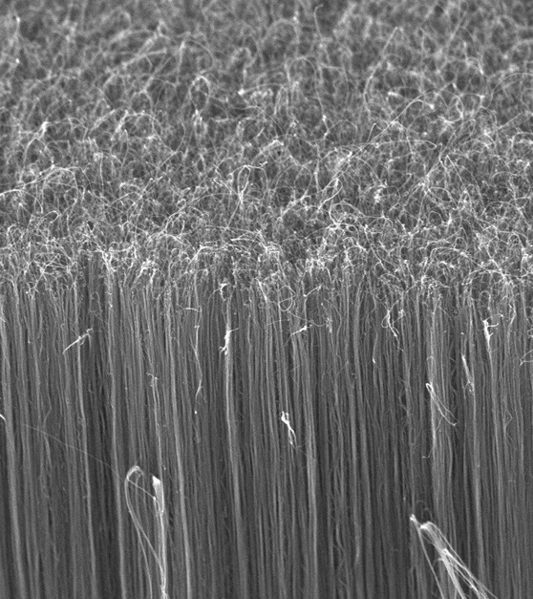



CURRENT SOLUTIONS
COATINGS
FILMS
NANOTUBES
D E G R A D E S
U N R E L I A B L E
E X P E N S I V E

Slide 4

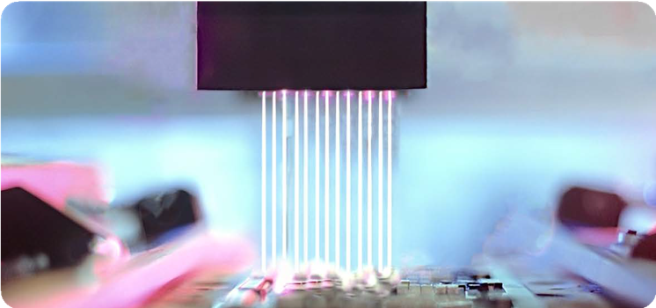
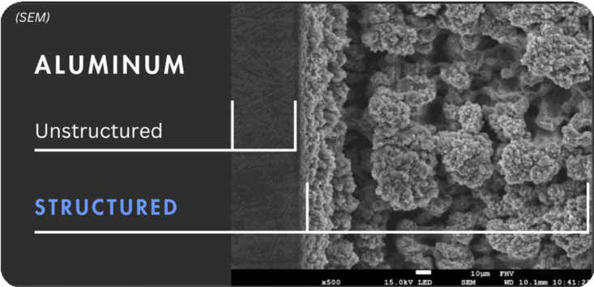

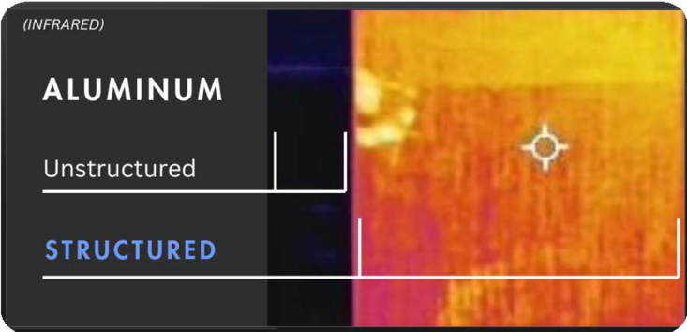
OUR SOLUTION
Proprietary ultrafast laser surface structuring (ULSS) process that creates feature-enhancing nanostructures that accelerate cooling by removing bottlenecks of heat for semiconductor, battery, solar and space components & materials.
Our process increases emissivity and optimizes heat transfer flow 2-5X for critical thermal management applications.

Slide 5

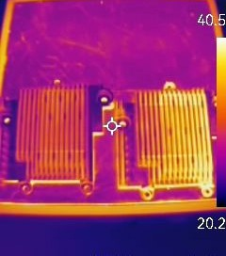

HEAT TRANSFER ENHANCEMENT VIA ULSS
Ultrafast Laser Surface-Structured
Non-Structured
5 Minute Time Period
Higher Heat Transfer Flow = Better Thermal Management

Slide 6
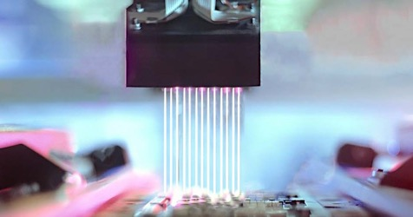
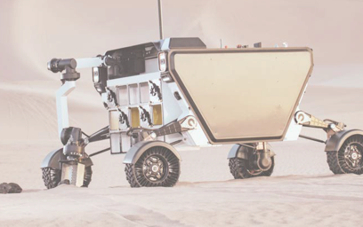

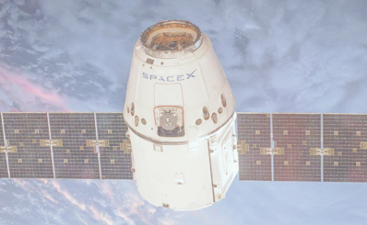
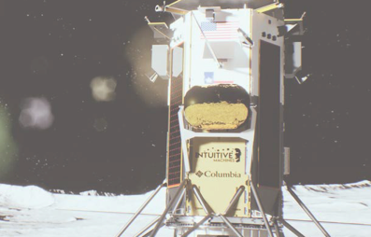
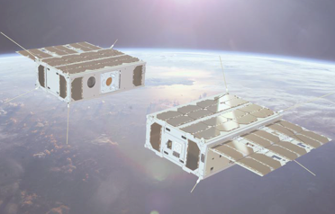
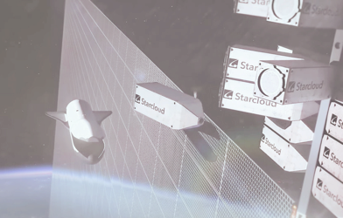
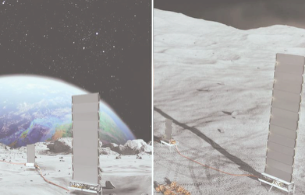



TARGET SPACECRAFT & COMPONENTS
ROVERS
LARGE SATELLITES
CUBESATS
DATA CENTERS
SURFACE POWER
LANDERS
THERMAL RADIATORS | HEAT SINKS | HEAT PIPES | HEAT SPREADERS | COLD PLATES

Slide 7



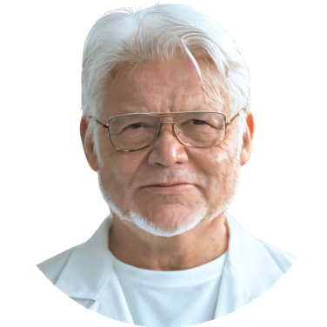
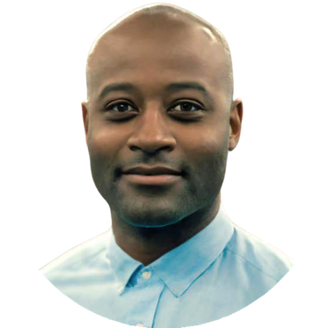


THE FOUNDERS
VICTOR A. RIVAS
CHAIRMAN, CO-FOUNDER & CTO
Patented our laser-based process focused on thermal management Worked for both NASA & U.S. Department of Energy
Expertise on material technologies
KENT CAMPBELL
CO-FOUNDER & CEO
Biz Dev background in global trade & international business
Manufacturing & supply chains expertise Former global trade specialist at U.S. Department of Commerce

Slide 8



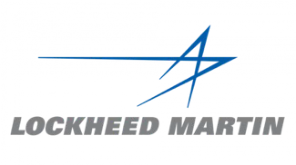









EARLY TRACTION
PAID PILOTS
EVER-GROWING NEED FOR THERMAL MANAGEMENT SOLUTIONS IN BOTH SPACE & TERRESTRIAL APPLICATIONS, EVEN AT PROTOTYPE STAGE TO DEAL WITH HEAT ISSUES.
NON-DISCLOSURE AGREEMENTS
ENTERPRISE ACCELERATORS & TECHNICAL DEMOS

Slide 9


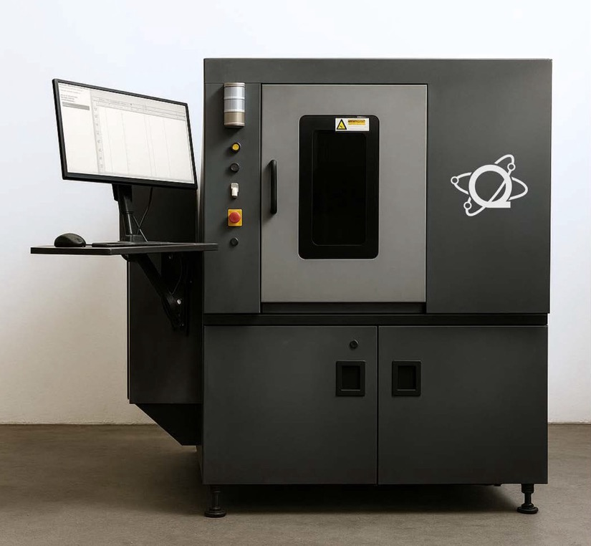

Q2 LASER STATION
The Q2 Laser Station deploys our proprietary ultrafast laser surface structuring process at scale.
The Q2 works on metals, non-metals, ceramics, and composites.
The Q2 is constructed to be modular, meet manufacturing end-user takt requirements and easily integrate into production lines.

Slide 10
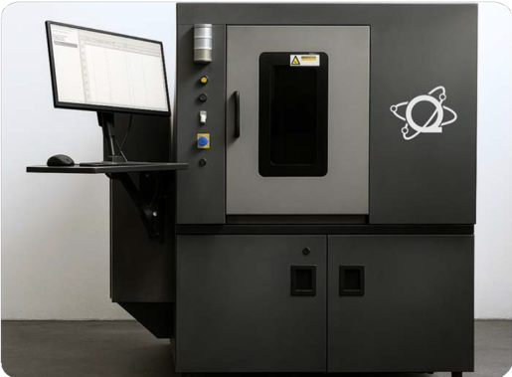
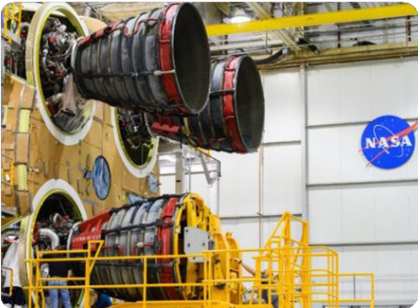
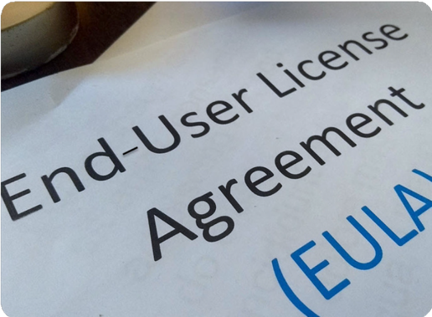

REVENUE STREAMS
ULTRAFAST LASER
STATION SALES
CONTRACT ULTRAFAST
LASER STRUCTURING
LICENSING
MODEL
MACHINES FOR INDUSTRIAL MANUFACTURERS & SUPPLIERS
MISSION-BASED CONTRACTS FROM NASA, DOD & PRIME CONTRACTORS
FOR EXCLUSIVE USAGE OF OUR LASER STRUCTURING PROCESS AT SCALE

Slide 11
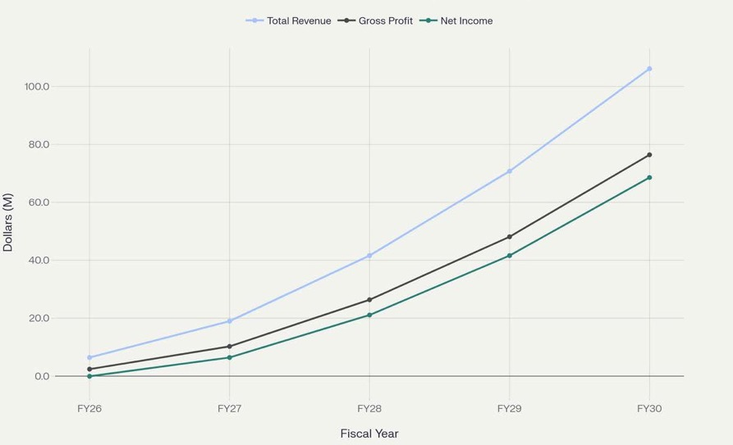
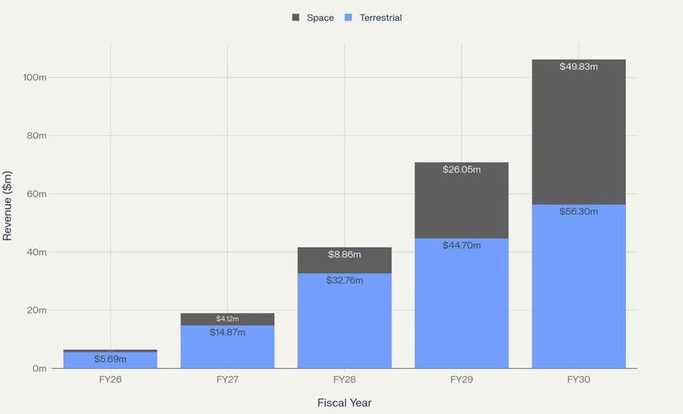
FINANCIAL HIGHLIGHTS
REVENUE TRAJECTORY
FY26 – FY30
REVENUE BY SEGMENT
FY26 – FY30
FY26: $6.4M (INITIAL COMMERCIAL ENTRY)
FY30: $106.1M (50% CAGR)
REVENUE MIX EVOLUTION: SPACE SEGMENT GROWS FROM 18% TO 47% OF TOTAL REVENUE

Slide 12

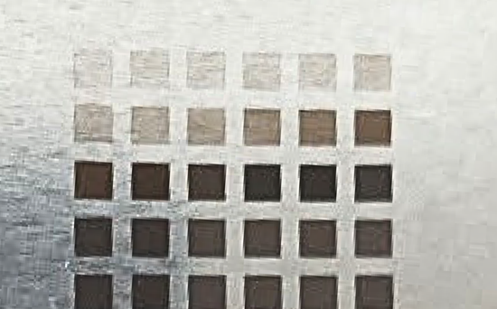
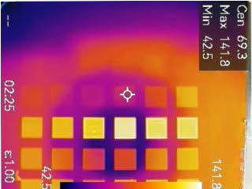



SO WHY TEST ON THE ISS?
In-orbit testing is needed to validate for customers in the space sector the durability & emissivity performance of ULSS metal samples regularly used for key thermal spacecraft components.
Testing will enable Quantum Qool to prove how its tailored nanostructures create a “plasmonic cooling” effect that keeps spacecraft cooler overall at scale.
Letters of Support:

Slide 13



CURRENT FUNDING ROUND
$1.4 MILLION
FUNDRAISE - OPEN THRU NOV.
USE OF FUNDS FOR PRE-SEED ROUND:
Bring on 3 Laser & Thermal Engineers and 2 Laser Technicians
Start build of ultrafast laser structuring robotics platform for macro applications
Full application lab buildout to serve more customers in-house faster
Development of laser parameter/ material data collection project for LLM proprietary platform with AWS
(CURRENTLY AT $1.2M COMMITTED)

Slide 14

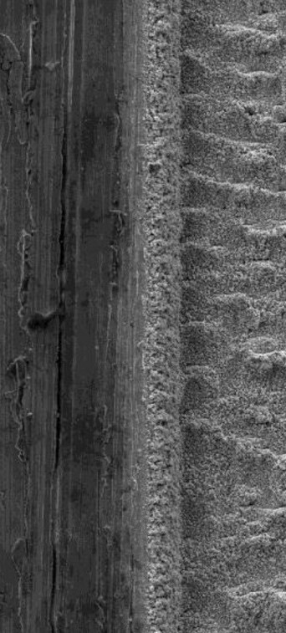


THANK YOU
FOR MORE INFORMATION:
KENT CAMPBELL
Co-Founder & CEO
kcampbell@quantumqool.com
VICTOR A. RIVAS
Co-Founder, CTO & Chairman
vrivas@quantumqool.com
LOCATIONS
Omaha / Washington DC
WEBSITE
www.quantumqool.com

